Slide 1
Impossibilities without impossibilia
Bjørn Jespersen, Utrecht University, TU Ostrava

Slide 2
Reasoning about vs from impossibilities
Difference between reasoning about and from impossibilities: (i) getting clear about the premise(s) and conclusion of a derivation and (ii) getting clear about the derivation itself of the conclusion from the premise(s). Consider this argument:
A divorced bachelor walks in the park
⎯⎯⎯⎯⎯⎯⎯⎯⎯⎯⎯⎯⎯⎯⎯
A man walks in the park
Valid? If so, how? In particular, does it follow vacuously, as per ex falso quodlibet? Or does nothing follow, apart from the premise itself (self-implication)? Neither explosion (‘everything goes’) nor sterility (‘nothing goes’) is desirable, because a logic requires that something goes, and something does not. The account of impossibilities offered in this talk is intended to underpin a logic for reasoning from impossibilities; here, by analyzing, inter alia, ‘is a divorced bachelor’.

Slide 3
Stage setting
The semantics and logic of impossibility: (i) predication
(ii) inference. Today: (i).
Are there impossible entities (impossibilia)? No, there aren’t. So, what are impossibilities (if anything)?
Conceptual vs objectual
Condition vs satisfier
Procedure vs product

Slide 4
Standard possible-world semantics
Hughes and Cresswell (1996, 15) sums up what standard possible-world semantics makes of the notion of impossibility:
Impossibility, along with necessity and possibility, is often also classified as a modal notion, but it does not call for special discussion here since there is no difficulty in expressing it by the operator ∼M (or alternatively L∼).
Where M is possibility and L necessity, impossibility can be expressed equivalently as the negation of possibility or the necessity of negation.
More formally, the dual of necessity being possibility: ◻α ↔ ¬◇¬α, or
◇α ↔ ¬◻¬α. Hence, this biconditional characterizes impossibility: ¬◇α ↔ ◻¬α. If impossibility is a primitive, ∎, we get: ∎α ↔ ◻¬α, or: ∎α ↔ ¬◇α.

Slide 5
Possibility vs impossibility
One difference between possibility and impossibility is this difference in inferential behavior. This is a well-known fallacy:
◇α, ◇β
⎯⎯⎯⎯⎯⎯⎯
◇(α∧β)
On the other hand, if ∎α is interpreted as ¬∃w (α_{w} = Τ), equivalent to ∀w (α_{w} = ⊥), and ∎β as ¬∃w (β_{w} = Τ), then it is obvious that there is no world at which ∎(α∧β) is true. Hence, this inference is valid:
∎α, ∎β
⎯⎯⎯⎯⎯⎯⎯ ∧I
∎(α∧β)
Similarly, if ∎ is replaced by ◻.

Slide 6
Modal fatigue I
Modal logic identifies logical equivalents. Hence, necessary co-extensionality equals co-intensionality, i.e., identity of intensions (e.g., larger-than and smaller-than are the same relation). Maybe sufficient for contingency. Not sufficient for necessity and impossibility:
The necessary proposition takes every world to the entire set of possible worlds (i.e., the logical space).
The impossible proposition takes every world to the empty set of possible worlds.
The impossible X maps onto a gap, an empty set, …

Slide 7
Modal fatigue II: examples
Must belief be consistent? KD45 requires it is due to seriality:
∀w ∃w′ (Rww′). So, where to go if a given belief is inconsistent?
“Assume for reductio that α is false.” So, what if α is a necessary truth?
“Any perpetuum mobile is nomologically impossible.” So, of what is nomological impossibility predicated? Impossible machine?
“If 6 were 9 then Vulcan would be the third rock from the Sun.” Counterpossibles (:counterfactuals with a necessarily false antecedent). Vacuous truth? Or differentiation of such antecedents?

Slide 8
Structuralism vs circumstantialism
Circumstantialist theories: truth-supporting circumstances as meanings. Modal Meinongianism is circumstantialist and immersed in the world idiom.
Structuralist theories: structures (incl. procedures) as meanings.
Structuralist theories: ‘Fregean’ and ‘Russellian’ variants, depending on whether only concepts or else both concepts and objects are permitted as constituents of structures.
‘Procedural Fregeanism’: a conceptual and top-down vs objectual and bottom-up theory of impossibility.

Slide 9
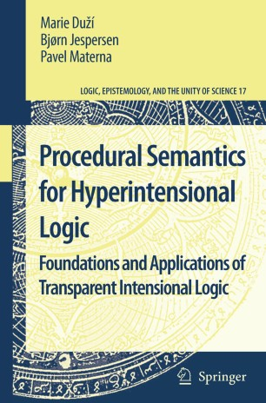
2010⁺
Since 2010, further research into:
Quantifying-in
Property modification
Topic/focus articulation
Inferences with hyperpropositions
Exact fine-graining of hyperpropositions
Various forms of β-conversion
Computational/procedural semantics
Fictional discourse
Assorted impossibilities
…

Slide 10
Transparent Intensional Logic: survey
TIL is a hyperintensional, partial, typed λ-calculus with a ramified type hierarchy.
Fine-grained meanings are procedurally structured flowcharts. They detail which logical operations to apply to which operands of which types to obtain a product of which type. TIL draws inspiration from Frege, Church, Montague, procedural semantics, functions-as-rules.
Its ideography is an interpreted λ-calculus whose terms denote procedures. The logic has three tiers (‘trickle-down’): procedures (:structured hyperintensions), conditions (such as intensions), satisfiers. Some procedures yield no product; some conditions have no satisfier.
Its modal logic is vintage S5 with a constant domain of bare individuals. Hence, BF and CBF are valid.
TIL’s account of impossibility (probably except for nomological necessity) is not modal/intensional, but procedural/hyperintensional.

Slide 11
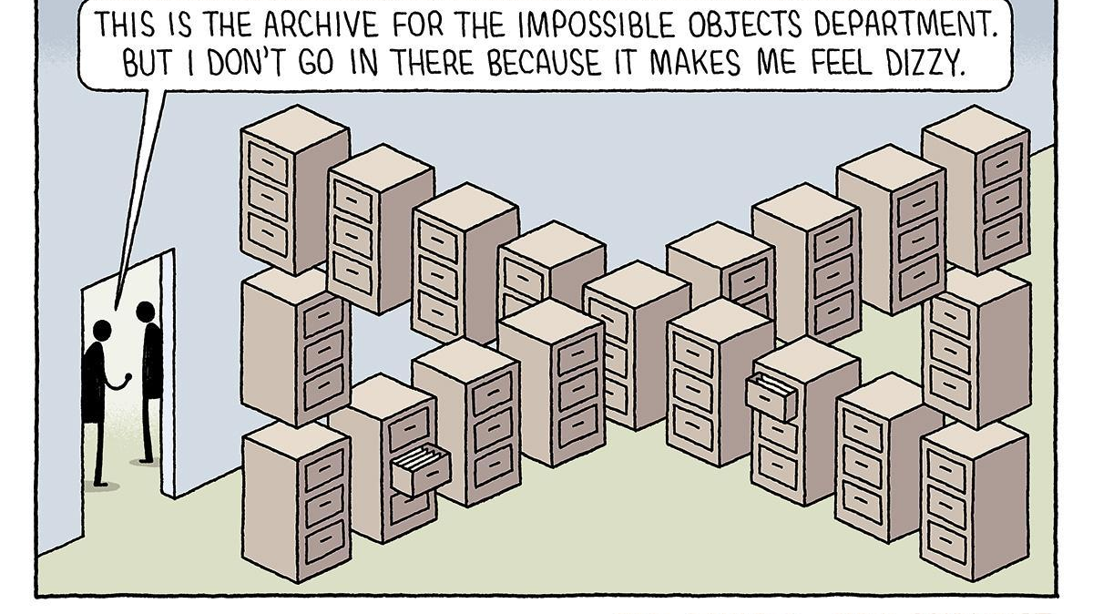
Meinongianism according to non-Meinongians

Slide 12
Reasoning about impossibility: metaphysics
Modal Meinongianism (Priest, Berto) expands logical space with impossible worlds as additional points of evaluation and adds to its constant domain impossible individuals as bearers of properties. Myriad impossibilia.
Zalta’s Meinongian Object Theory comes with two categories of objects: ordinary and abstract objects. Ordinary objects exemplify properties by instantiating them; abstract objects encode properties without instantiating them. No impossibilia.
TIL could make sense of ‘impossible world’ as a condition that no possible world could possibly satisfy, and ‘impossible individual’ as a condition that no individual could possibly satisfy. Hence, a so-called impossible X would not be an X, ‘impossible’ having a privative effect. TIL does not want to explain impossibility in terms of impossibilia. No impossibilia.

Slide 13
Reasoning about impossibility: objective
The objective is not to find fault with impossibilia-embracing theories of impossibility such as modal Meinongianism and then come forward with a superior proposal.
The objective is to start out with an existing theory (TIL) and develop a theory of impossibility within it, a ‘procedural Fregeanism’. As a self-declared global theory of the logic of meaning, TIL owes an account of impossibility.
Therefore, what does a procedural (hence, structuralist) theory of impossibility look like?

Slide 14
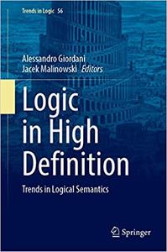
ss
‘Impossible individuals as necessarily empty individual concepts’ (with M. Duží and D. Glavaničová), in: Logic in High Definition, Trends in Logic (Studia Logica Library), vol. 56 (2021), A. Giordani, J. Malinowski (eds.), 177-202.

Slide 15
Reasoning about impossibility: TIL methodology
A TIL analysis of a piece of language amounts to assigning a procedure (in accordance with the definition of procedure below) to it as its meaning; more specifically, assigning the logical structure of its meaning from which to draw inferences.
This procedure is structured to display a logical trajectory toward an entity of a particular type (in accordance with the definitions of ramified and simple types). The procedure produces this entity or else fails to produce anything. This type may be either the type of a condition (:function) or of a non-condition, i.e., an object that can satisfy a condition but is not itself one (formally, a medadic function).

Slide 16
Contradiction and truth-value gaps
A∧¬A is a contradiction, even though one of the conjuncts is gappy, provided a contradiction is any formula that is necessarily not T.
Necessarily not being T is compatible with being F or being gappy.
(Translated into TIL: The procedure A∧¬A produces a contradiction, even when one of the conjuncts is improper (:does not produce anything), provided a procedure producing a contradiction is understood to be a procedure that necessarily does not produce T, but either produces F or is improper.)
Trivial remark. To demonstrate incompatibility, any contradiction will do, e.g., A∧¬A, but also, say, ¬(A→A).

Slide 17
Reasoning about impossibility: TIL methodology, three examples
The definite description ‘the largest natural number’ expresses a procedure that is structured and typed to produce an entity typed as a natural number. The procedure produces nothing and so qualifies as an improper procedure. ‘Empty terms’ are individuated hyperintensionally.
The predicate ‘is a natural number between 0 and 1’ expresses a procedure that is structured and typed to produce an entity typed as a set of natural numbers. The procedure produces ∅^{ℕ}. TIL comes with a fully typed universe, and each type comes with its own empty set.
The predicate ‘is a barber who shaves exactly those who do not shave themselves’ expresses a procedure that is structured and typed to produce an entity typed as a property of individuals (:a mapping from possible worlds to a mapping from times to sets of individuals). This property is the impossible property of individuals: it returns ∅^{ι} at all empirical indices.

Slide 18
TIL: definitions I (procedure)
Variables x, y, … are procedures that produce objects (elements of their respective ranges) dependently on a valuation v; they v-produce.
Where X is an object whatsoever (an extension, an intension or a procedure), ⁰X is the procedure Trivialization. ⁰X produces X without any change of X.
Let X, Y₁, …, Y_{n} be arbitrary procedures. Then Composition [X Y₁…Y_{n}] is the following procedure. For any valuation v, the Composition [X Y₁…Y_{n}] is v-improper if at least one of the procedures X, Y₁, …, Y_{n} is v-improper by failing to v-produce anything, or if X does not v-produce a function that is defined at the n-tuple of objects v-produced by Y₁,…,Y_{n}. If X does v-produce such a function, then [X Y₁…Y_{n}] v-produces the value of this function at the n-tuple.
The (λ-) Closure [λx₁…x_{m} Y] is the following procedure. Let x₁, x₂, …, x_{m} be pair-wise distinct variables and Y a procedure. Then [λx₁…x_{m} Y] v-produces the function f that takes any members B₁, …, B_{m} of the respective ranges of the variables x₁, …, x_{m} into the object (if any) that is v(B₁/x₁,…,B_{m}/x_{m})-produced by Y, where v(B₁/x₁, …, B_{m}/x_{m}) is like v except for assigning B₁ to x₁, …, B_{m} to x_{m}.
Nothing is a procedure, unless it so follows from (i) through (v). 

Slide 19
TIL: definitions II (simple types)
Let B be a base, where a base is a collection of pair-wise disjoint, non-empty sets. Then:
Every member of B is an elementary type of order 1 over B.
Let α, β₁, ..., β_{m} (m > 0) be types of order 1 over B. Then the collection (α β₁ ... β_{m}) of all m-ary partial mappings from β₁ × ... × β_{m} into α is a functional type of order 1 over B.
Nothing is a type of order 1 over B unless it so follows from (i) and (ii). 
Basic types for natural-language analysis:
ο the set of truth-values {T, F}
ι the set of individuals (the universe of discourse)
τ the set of real numbers (doubling as times)
ω the set of logically possible worlds (the logical space)

Slide 20
Intensions; explicit intensionalization and temporalization
Characteristic function (here, set of individuals) / (οι)
Set-in-intension (here, property of individuals) / (οι)_{τω}
Individual-in-intension (individual office or role) / ι_{τω}
Truth-value-in-intension (truth-condition or PWS proposition) / ο_{τω}
Binary relation-in-intension (here, attitude) / (οια)_{τω}
The following schematic formula is characteristic of explicit intensionalization and temporalization:
λwλt [… w …. t …]

Slide 21
TIL: definitions III (ramified type hierarchy)
C_{n} (procedures of order n)
Let x be a variable ranging over a type of order n. Then x is a procedure of order n over B.
Let X be a member of a type of order n. Then ⁰X, ²X are procedures of order n over B.
Let X, X₁, ..., X_{m} (m > 0) be procedures of order n over B. Then [X X₁... X_{m}] is a procedure of order n over B.
Let x₁, ..., x_{m}, X (m > 0) be procedures of order n over B. Then [λx₁...x_{m} X] is a procedure of order n over B.
Nothing is a procedure of order n over B unless it so follows from C_{n} (i)-(iv).
T_{n+1} (types of order n+1). Let ∗_{n} be the collection of all procedures of order n over B. Then:
∗_{n} and every type of order n are types of order n + 1.
If m > 0 and α, β₁, ..., β_{m} are types of order n + 1 over B, then (α β₁ ... β_{m}) (see T₁ ii)) is a type of order n + 1 over B.
Nothing is a type of order n + 1 over B unless it so follows from T_{n+1} (i) and (ii). 

Slide 22
TIL: formalization of three procedures
the largest prime
[⁰℩λx [[⁰Prime x] ∧ ⁰∀λy [[⁰Prime y] ⊃ [⁰≥ x y]]]]
is a natural number between 0 and 1
λx [[⁰> x ⁰0] ∧ [⁰< x ⁰1]]
is a barber who shaves exactly those who do not shave themselves
λwλt [λx [⁰B_{wt} x ∧ ⁰∀λy [[⁰S_{wt} xy] ↔ ¬[⁰S_{wt} yy]]]]

Slide 23
1st example: The largest prime is a prime
Types: ο (truth-values); ν (natural numbers); ℩/(ν(ον)); Prime/(ον)
[⁰Prime [⁰℩λy [[⁰Prime y] ∧ ⁰∀λz [[⁰Prime z] ⊃ [⁰≥ y z]]]]]

Slide 24
Improper (‘empty’) Composition
The Composition
[⁰℩λy [[⁰Prime y] ∧ ⁰∀λz [[⁰Prime z] ⊃ [⁰≥ y z]]]]
is structured and typed to produce a set of primes and then extract its single element. However, as a matter of arithmetic fact, there is no such singleton. Hence, the Closure
λy [[⁰Prime y] ∧ ⁰∀λz [[⁰Prime z] ⊃ [⁰≥ y z]]]
produces the empty set of ν-typed entities.
Hence, the function denoted by the functor ‘℩’ is undefined at the argument produced by this Closure. The logical effect is that the Composition is v-improper for all valuations v, i.e., improper simpliciter.

Slide 25
Definition (strictly empty procedure). Two sources of improperness
Let C be a procedure. Then C is a strictly empty procedure iff C is improper. 
Remark 1. Being improper is a property of procedures, hence of type (ο*_{n}). A procedure is improper when it is v-improper for any valuation v.
Remark 2. No variable or Trivialization can be improper. The functions assigning values to variables are total functions. And a Trivialization presupposes the existence of the entity to be Trivialized. Nor can Closures be improper, for a Closure will, at the very least, produce a degenerate function. Only Compositions are capable of being improper.
Remark 3. There are two sources of improperness. One is that a function f, though having an argument a, returns no value b at a; that is, f(a) is a blank. The other is that f receives no argument a and so cannot return a value b at a; that is, f trades a blank for a blank. This happens when a subprocedure of a Composition C is improper, causing C to be improper. No execution of application, hence no descent from procedure to product. Still, the very procedure of functional application remains intact.

Slide 26
Predication with extensional occurrence (‘de re’): truth-value gap
Any attempt at predication would grind to a standstill, if predication required us to first identify a referent and then predicate a property of it. This appears to rule out predication with extensional occurrence of a procedure as meaningful, though in TIL it does not. Because we are not invoking impossibilia, the right approach is not, even as a façon de parler, to describe an impossible prime number. We are describing no numbers.
We are describing a logical procedure that is structured and typed to yield a number (here, a ν-typed entity) that satisfies a uniqueness condition applicable to ν-typed entities. Since Compositions can be improper, the Composition
[⁰℩λy [[⁰Prime y] ∧ ⁰∀λz [[⁰Prime z] ⊃ [⁰≥ y z]]]]
can be parsed as “Whatever prime is the largest, if any, is a prime”.
The Composition being improper has as a result that the function produced by ⁰Prime fails to receive an argument and, therefore, cannot yield a value, in this case an ο-typed entity (i.e., a truth-value). Therefore, the Composition
[⁰Prime [⁰℩λy [[⁰Prime y] ∧ ⁰∀λz [[⁰Prime z] ⊃ [⁰≥ y z]]]]]
is improper.
Upshot: it is neither true nor false that the largest prime is a prime.

Slide 27
Predication with hyperintensional occurrence (‘de dicto’): T
Alternative: let the procedure
[⁰℩λy [[⁰Prime y] ∧ ⁰∀λz [[⁰Prime z] ⊃ [⁰≥ y z]]]]
occur hyperintensionally (rather than extensionally). This means that this Composition itself becomes a functional argument. Let also the Trivialization ⁰Prime occur hyperintensionally. Then:
[⁰Subsume ⁰⁰Prime ⁰[⁰℩λy [[⁰Prime y] ∧ ⁰∀λz [[⁰Prime z] ⊃ [⁰≥ y z]]]]]
Subsume/(ο*_{n}*_{n}). Upshot: the product is T.

Slide 28
2nd example: intension-involving (‘empirical’)
1. Fabrizio is a divorced bachelor (intersective modification)
2. Fabrizio is divorced, and Fabrizio is a bachelor
3. λwλt [[⁰Divorced_{wt} ⁰Fab] ∧ [⁰Bachelor_{wt} ⁰Fab]] (requisites)
4. λwλt [[λx [[⁰Previously_Married_{wt} x] ∧
¬[⁰Previously_Married_{wt} x]]] ⁰Fab]
The constant value of the intension produced by
λwλt [λx [[⁰Previously_Married_{wt} x] ∧ ¬[⁰Previously_Married_{wt} x]]]
is ∅^{ι}.

Slide 29
Definition (empirical procedure) & corollary
Let C be a procedure. Then C is an empirical procedure iff C produces a non-constant intension. 
Corollary. A Closure of the form λwλt [… w …. t …] that produces a constant intension is a non-empirical procedure: no divergence between any two random world/time pairs. The extension is either a gap or an empty set, depending on the type of the extension of this intension.
Remark. For impossibility, we need either a constant intension of the above kind (gap/∅^{α}) or a non-constant intension nowhere and never returning T (but either gaps or F). Remember that properties and relations are identified with their characteristic functions (οα).

Slide 30
Definition (requisite relation between properties of individuals)
Let C, D be procedures such that C, D/*_{n} → (οι)_{τω}; x → ι. Then:
[⁰Req D C] = [⁰∀λw [⁰∀λt [⁰∀λx [[⁰True_{wt} λwλt [C_{wt} x]] ⊃
[⁰True_{wt} λwλt [D_{wt} x]]]]]]. 
Remark. The underlying idea behind requisites is that a set of requisites are individually necessary and jointly sufficient for an individual to instantiate the initial property.

Slide 31
Definition (refinement of procedure)
Let C be a molecular closed procedure producing entity Y. Then C is an ontological definition of Y. 
Let C₁, C₂, C₃ be procedures. Let ⁰Y be a Trivialization of Y and let ⁰Y occur as a subprocedure in executed mode within C₁. If C₂ differs from C₁ only by containing instead of ⁰Y an ontological definition of Y, then C₂ is a refinement (type: (ο*_{n}*_{n})) of C₁. If C₃ is a refinement of C₂ and C₂ a refinement of C₁ then C₃ is a refinement of C₁. 
Example. ⁰Prime is refined into λx [⁰Card λy [⁰Divide y x] = ⁰2].

Slide 32
Dual predication for intensions
Predication de re λwλt [F_{wt} Off_{wt}] The occupant is an F
Predication de dicto λwλt [F′_{wt} Off] The office is an F′
Predication de dicto [⁰Req F Off] F is a requisite of the office
F/*_{n} → (οι)_{τω}; F′/*_{n} → (οι _{τω})_{τω}; Off/*_{n} → ι_{τω}; Req/(ο (οι)_{τω} ι_{τω}).

Slide 33
3rd example: ‘impossible’ belief
Tilman believes that some orchids are reptiles
Attitude complement: λwλt [⁰∃λx [[⁰Orchid_{wt} x] ∧ [⁰Reptile_{wt} x]]]
Attitude:
λwλt [⁰Bel_{wt} ⁰Tilman ⁰[λw′λt′ [⁰∃λx [⁰Orchid_{w′t′} x ∧ ⁰Reptile _{w′t′} x]]]]
Bel/(οι*_{n})_{τω}

Slide 34
Quantifying-in (:reasoning about impossibilities)
[⁰Bel_{wt} ⁰Tilman ⁰[λw′λt′ [⁰∃λx [⁰Orchid_{w′t′} x ∧ ⁰Reptile _{w′t′} x]]]]
⎯⎯⎯⎯⎯⎯⎯⎯⎯⎯⎯⎯⎯⎯⎯⎯⎯⎯⎯⎯⎯⎯⎯⎯⎯⎯⎯⎯⎯⎯⎯⎯
[⁰∃λf [⁰Bel_{wt} ⁰Tilman [⁰Sub [⁰Tr f] ⁰p ⁰[λw′λt′ [⁰∃λx [p_{w′t′} x ∧ ⁰Reptile _{w′t′} x]]]]]]
Gloss: “There is a property f such that Tilman believes that some fs are reptiles”.
Types: f, p/*_{n}→(οι)_{τω}.

Slide 35
Rule for quantifying-in
[B_{wt} a ⁰P(⁰b/y)]
⎯⎯⎯⎯⎯⎯⎯⎯⎯⎯⎯⎯⎯⎯⎯⎯⎯⎯⎯⎯
[⁰∃ λx [B_{wt} a [⁰Sub [⁰Tr^{α} x] ⁰y ⁰P(y)]]]
Types: P(⁰b/y)/∗_{n}: a procedure with a proper constituent ⁰b/∗_{n} → α that has been substituted for the variable y/∗_{n} → α; x/∗_{n} → α. Proof:
[B_{wt} a ⁰P(⁰b/y)] ∅
[B_{wt} a [⁰Sub [⁰Tr^{α} ⁰b] ⁰y ⁰P(y)]] = [B_{wt} a ⁰P(⁰b/y)] Def.
[λx [B_{wt} a [⁰Sub [⁰Tr^{α} x] ⁰y ⁰P(y)]] ⁰b] 2, β-expansion
[⁰∃ λx [B_{wt} a [⁰Sub [⁰Tr^{α} x] ⁰y ⁰P(y)]]] 3, Def.
Step (4) is justified, because the class of α-objects produced by the Closure λx [B_{wt} a [⁰Sub [⁰Tr^{α} x] ⁰y ⁰P(y)]] is non-empty, as it contains at least the object b.
Remark. In this rule, x occurs free in the Composition [⁰Sub [⁰Tr^{α} x] ⁰y ⁰P(y)], whereby it lends itself to being λ-bound.

